Slide 1
Kansas City Plant Transformation and
Inventory Reduction
Nancy Turner
Manager, Inventory Mgmt.
Kansas City Plant
816-997-4983

Slide 2
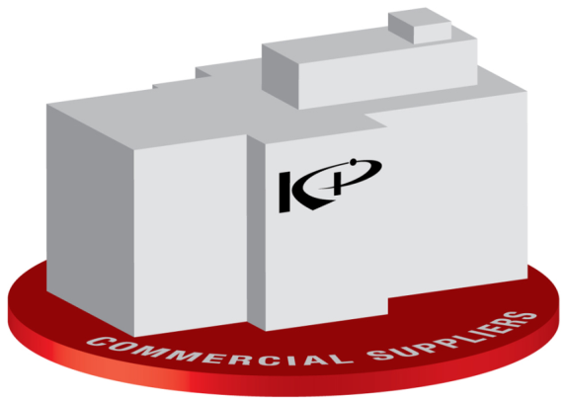

KCRIMS
Kansas City Responsive Infrastructure Manufacturing & Sourcing
The Transformation of the Kansas City Plant
January 23, 2008
“There are risks and costs to a plan of action,
but they are far less than the long range risks and costs
of comfortable inaction.”
- John F. Kennedy

Slide 3
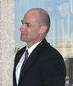
NNSA Complex Transformation
“Planning Scenario”
Tom D’Agostino testimony to Congress, 4/5/06. Actions relevant to the Kansas City Plant:
  Where possible and cost-effective, relatively more non-nuclear components would be purchased from commercial suppliers compared with today. A new, modern and efficient non-nuclear production facility would be in operation by 2012 and sized to produce components and conduct operations that cannot be purchased commercially (e.g. use control components and component final assembly).
  Initiate a Supply Chain Management Center at Kansas City by the end of 2007 to centralize some procurement activities consistent with the Task Force’s recommendation.

Slide 4
KCRIMS Transformation Plan Elements
Current
KCP
KCRIMS
Kansas City Responsive Infrastructure Manufacturing & Sourcing
NWC
Integration
Integrated
Interdependent
Enterprise
Maintenance
of
Capability
Revised
Oversight
Model
Business
Process
Transformation
Responsive
Infrastructure
Supply Chain Management
Integrated Program Management
Life Cycle Support
Strategic
Sourcing
& Sizing
New
Facility
Commercial
Supply
Base
Commercial
Supply
Base
Unified Supply Base
Baseline Change Control
Integrated Schedule
Cost Control
Shared Resources
Modern Infrastructure
1.0 M ft²
2000 employees
Low fixed costs
Reconfigurable
65% outsourced
63 years old
3.1 M ft²
2900 employees
High fixed costs
Low utilization
50% outsourced

Slide 5
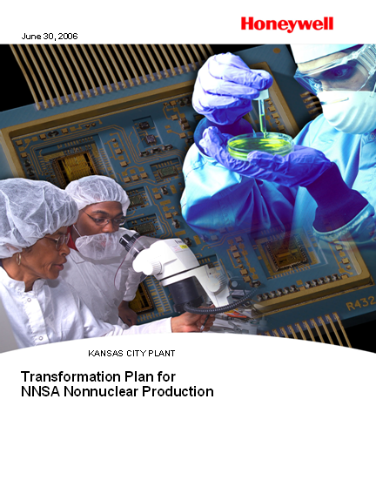
KCRIMS Transformation Plan Elements
Major Elements:
Transition to more process-based production operations with appropriate capacity and additional outsourcing. (Strategic Sourcing & Sizing)
Implement business process transformation with more commercial-like practices rather than those driven by federal regulation and oversight. (Business Process Transformation)
Construct a 1M ft² facility to enable savings and RRW development and qualification in 2012. (New Facility)
Transformation will result in approximately $100M of annual operational cost savings when fully implemented. Non-Weapons related business potentially separated.

Slide 6
KCRIMS Transformation Plan Elements
Strategic Sourcing and Sizing Plan:
From To
Manufacturing Space 1.26 M 0.65 M
Administrative Space 1.84 M 0.35 M
Total Usable Space 3.10 M 1.00 M
From To
Make Parts (approx) 3800 (46%) 2900 (35%)
Buy Parts (approx) 4400 (54%) 5300 (65%)
Major Outsourced Processes:
  Sheet Metal
  Plating
  Cables
  Heavy Machining
Injection Molding
Printed Wiring Boards
Several Partial
Processes No Longer Supported:
  Liquid Spray Paint
  Tape Wrap
  LIGA
  Several Minor

Slide 7
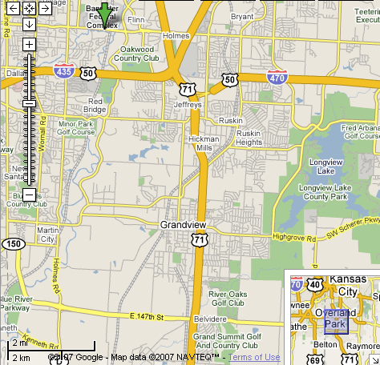
KCRIMS New Plant Preferred Site
GSA has identified 185 acres of land at the northeast corner of 150 Highway and Botts Road in Kansas City, Mo., as the preferred site for the new Kansas City Plant
Selection was based on a number of objective criteria including employee commute, highway access and utilities, and compatibility of adjacent development
The project has been approved by the Office of Management and Budget and Congress.
This preferred site is subject to the successful completion of the NEPA process.
New
Site
Notes:
GSA
Brad talks to this

Slide 8
KCRIMS Schedule & Financial Model
First Budget Input (with Escalation)
2006
2007
2008
2009
2010
2011
2012
2013
2014
2015
Business Cases
& Approvals
Bid
Design and Build
Transition to New
Decommission Legacy Plant
Operational Cost Model
Finish
Build Ahead
Relocation
Re-Qual Costs
FY05 FYNSP Baseline
Long Term Savings
Millions of Dollars
Facility
Maintenance Savings
FY09 Budget Input
Actual Performance
(Labor Reductions)
KCRIMS FY09 Budget Input
FY05 FYNSP (Project Baseline)
9/20/07

Slide 9
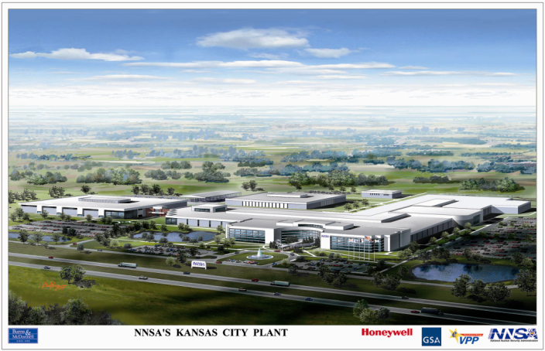
New KCP – Conceptual Artist Rendering

Slide 10
KCP Inventory Reduction
Inventory Reduction Plan
  Move from 300,000 sq. ft. to 66,000 sq. ft. (78% reduction in storage space)
  Storage space reduction will be achieved through the following methods
    Identifying and disposing of unneeded materials
    Establishing a storage cost charging process for inventory
    Utilizing alternative methods to acquire needed operating supplies
    More efficient methods of storage and consolidation.

Slide 11
KCP Inventory Reduction

Slide 12
KCP Inventory Reduction
Inventory Reduction Execution Process
  Identify surplus material candidates
    KCP surplus inventory consists of items related to enduring stockpile program support and surveillance activities, in excess of known and planned requirements
  Internal review with KCP engineering and program management
    Includes discussion with DA counterparts
  Send request to excess to NNSA/AL for review and complex wide circulation
  Execute disposal of unneeded materials

Slide 13
KCP Inventory Reduction
Disposal of approved excess material
  KCP utilizes Excess & Reclamation guidelines per nonproliferation treaty and federal regulations
  Joe Gazda memo (5/8/06) – organizations requesting to preserve inventory in excess of requirements must submit written request through NA-122 and will have the following options:
    Become custodian of the items at their site
    or
    Provide funding for storage and management of items at KCP

Slide 14
KCP Inventory Reduction
D&P Manual Changes
  During 2007, we worked with the NNSA to revise the Development and Production (D&P) manual Chapter 4.1 Inventory and Disposition of Nonnuclear weapons materials and Special Tooling & Acceptance Equipment
  The goal was to revise guidance on what inventory quantities were required to be retained, in light of years of schedule reductions, and to align retention options with headquarters expectations.

Slide 15
KCP Inventory Reduction
Section 2.0 BACKGROUND
Production Agencies (PAs) have the responsibility to—
maintain the minimum quantities (including quantities to support attrition
rates, yields, etc.) of War Reserve (WR) non-nuclear material for supporting
authorized and planned requirements identified in the Weapon Program
Control Document (Weapon PCD) or other formal planning/guidance
documents.
maintain an inventory of tooling and acceptance equipment for supporting
authorized and planned requirements identified in the Weapon PCD or other
formal planning/guidance documents.
D&P manual chapter 4.1 revision 8/22/2007

Slide 16
KCP Inventory Reduction
Section 2.0 BACKGROUND (continued)
Identification of Excess or Disposition
· Non-nuclear Material--If sufficient ship- or lower-level assemblies exist to support the requirements, then sub-assemblies and sub-assembly
components can be considered excess. Once non-nuclear material is
identified as excess to requirements, it will be made available for other uses. If no other uses are identified, the material will be dispositioned in
accordance with approved procedures.
· Special Tooling & Acceptance Equipment-- Once tooling and acceptance equipment is identified as excess to requirements it will be made available for other uses. If no other uses are identified, the tooling will be dispositioned in accordance with approved procedures. Authority to make a decision to identify tooling and acceptance equipment for final disposition depends on the nature of the equipment and its funding source.
D&P manual chapter 4.1 revision 8/22/2007

Slide 17
KCP Inventory Reduction
5.2.1 Request to Hold Reserve Inventory
An organization that wishes a PA to hold non-nuclear material or special
tooling & acceptance equipment in reserve inventory shall submit a written request to NA-122 that specifies the items to be held in a reserve inventory status at the PA.
The Request to Hold Reserve Inventory shall contain the following information:· part number, nomenclature, quantity to be held, its planned use, justification or rationale for retaining these items in reserve inventory at the PAs, and an estimate of the time it is to be held in reserve inventory.
Depending on the justification to hold the non-nuclear material or special
tooling & acceptance equipment in reserve, the requesting organizations may be required to—
1. become the custodian of the items at their site to include final disposition or
2. provide funding for storage and management of the items at the PA.
D&P manual chapter 4.1 revision 8/22/2007

Slide 18
KCP Inventory Reduction
Outsourcing storage strategies
  Chemical storage
    Plan to pursue vendor managed off-site storage where possible
    Plan to review production chemical requirements for potential usage standardization
  Maintenance, Repair and Operating (MRO) storage
    Reduced volumes due to smaller infrastructure to support
    Plan to purchase and receive general operating supplies as needed

Slide 19
KCP Inventory Reduction
Space Consolidation/Utilization Methods
  New storage systems
    High bay, narrow aisle storage replaces existing less efficient storage methods
    New automated retriever system
  Transactional segregation
    More efficient use of available space, replaces current requirement for physical separation of production and non-production materials

Slide 20
